Slide 1
COMP 3311 Database Management Systems
Lab 1. Introduction to Oracle and Oracle SQL Developer

Slide 2
Objectives of the Lab
After this lab you should be able to
Know some basics of Oracle DBMS.
Know how to connect Oracle DBMS with SQL Developer.
Run script files on the Oracle DBMS through the SQL Developer.
Issue simple SQL commands to Oracle DBMS through SQL Developer.

Slide 3
Why Oracle?
Oracle database system is the one of the most widely used commercial DataBase Management Systems (DBMS).
Other DBMSs are similar to the Oracle database system - you should be able to program with other DBMSs, if you are familiar with the Oracle system.

Slide 4
Why Oracle?
Knowing Oracle, you will find it easier to switch to any other database products, e.g. SQL server, MySQL.
Oracle has the most sophisticated functions such as PL/SQL.
Oracle has many supports for database users.

Slide 5
Getting the Oracle
We recommend you to use the Oracle server provided by CSE department – account and password will be given now.
It could be tricky to install and uninstall Oracle DBMS on your laptop.
You can connect to Oracle server provided by CSE through Oracle SQL Developer.

Slide 6
More about Oracle database
Based on the relational model proposed by E.F Codd.
The first commercially available SQL based database system.
Having supported the Client-Server model (will discuss) since version 5.
The latest stable version is Oracle Database 19c (c for cloud).

Slide 7



The Oracle Client/Server model
SQL statements
Oracle
Database server
SQL Developer
Query results
SQL statements
SQL script files
We have installed SQL Developer in our Labs
You are encouraged to install SQL Developer in your own machines
7

Slide 8
SQL Developer
A free integrated development environment that simplifies the development and management of Database in traditional and cloud deployments.
SQL Developer offers
A complete end-to-end development of your PL/SQL applications,
A worksheet for running queries and scripts,
A DBA console for managing the database,
A reports interface,
A complete data modeling solution, and
A migration platform for moving your 3rd party databases/excel to Oracle.

Slide 9
Instructions
You need to do the followings for the lab:
1. Download SQL Developer. (Appendix 1)
Register your own account at oracle.com with your own email.
2. Connect to UST network via HKUST VPN. (Appendix 2)
3. Connect to COMP3311 database in SQL Developer interface. (Appendix 3)
Use the provided account/password in oracle account.xlsx
4. Run the script file (lab1.sql) in SQL Developer interface.

Slide 10
Appendix 1: Installing SQL Developer 1
Read the information and Download SQL Developer Release 23.1 from Oracle:
Oracle SQL Developer Downloads
Accept License Agreement and download suitable SQL Developer in your machine
(Optional) Download JDK if it is not installed
References:
SQL Developer 23.1.0 Release Notes (oracle.com)
SQL Developer Concepts and Usage (oracle.com)

Slide 11
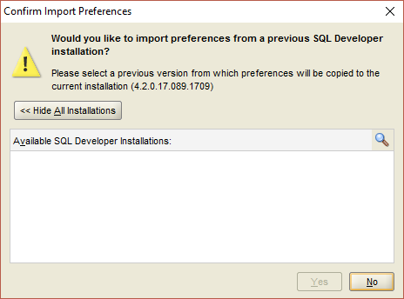
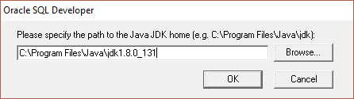
Appendix 1: Installing SQL Developer 2
Unzip SQL Developer folder
Run sqldeveloper.exe (on windows) or sh sqldeveloper.sh (on Linux and Mac OS X)
Optional Settings:
Select the path of java JDK home
Select No for Confirm Import Preferences

Slide 12
Appendix 2: Connecting to UST network 1
Only computer connected to the UST network can access the CSE Oracle server.
To connect to UST network outside the campus, you should use VPN (Pulse Secure)
Install Secure Remote Access ( SSL VPN Service ) client provided by ITSC https://itsc.ust.hk/apps/vpn/client.html
Connection Establishment https://itsc.ust.hk/apps/vpn/conn_win.html

Slide 13
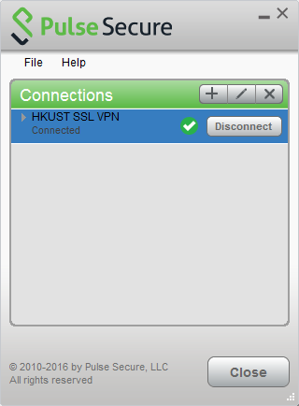
Appendix 2: Connecting to UST network 2
Double-click Pulse icon in the notification area to launch the SSL VPN client
Click Connect to connect to the SSL VPN gateway
Enter your ITSC Network Account information User Name: ITSC Network Account Password: ITSC Network Account Password
Press Connect to connect (Press Approve on your phone if you have enrolled in Two-Factor Authentication (2FA))
You can press Disconnect to end your connection

Slide 14
SQL Developer User Interface 1
Icons under the menus perform various actions, including the following:
New creates a new a new database object.
Open opens a file.
Save saves any changes to the currently selected object.
Save All saves any changes to all open objects.
Back moves to the pane that you most recently visited.
Forward moves to the pane after the current one in the list of visited panes. (Or use the drop-down arrow to specify a tab view.)
Open SQL Worksheet opens the SQL Worksheet. If you do not use the drop-down arrow to specify the database connection to use, you are asked to select a connection.

Slide 15
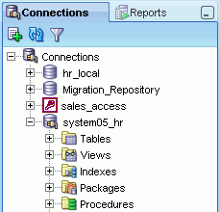

SQL Developer User Interface 2
The Connections navigator lists database connections that have been created.
The Files navigator displays your local file system using a standard hierarchy of folders and files. You can double-click or drag and drop files to open them, and you can edit and save the files.

Slide 16
SQL Developer User Interface 3
Icons under the Connections tab perform the following actions on the currently selected object:
Refresh queries the database for the current details about the selected object (for example, a connection or just a table).
Apply Filter restricts the display of objects using a filter that you specify. To remove the effects of applying a filter, right-click the node and select Clear Filter
The right side of the SQL Developer window has tabs and panes for objects that you select or open.

Slide 17
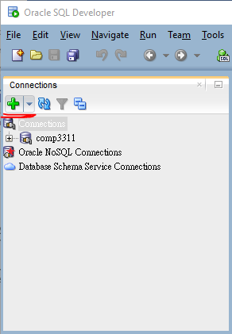
Connecting to Oracle database server 1
Create new database connection
Get your Oracle username and password from the following URL
Will be provided in the lab class*- (need update)
Connection type | Basic
Hostname | dbsvr1.cse.ust.hk
Port | 1521
Service name | comp3311.cse.ust.hk

Slide 18
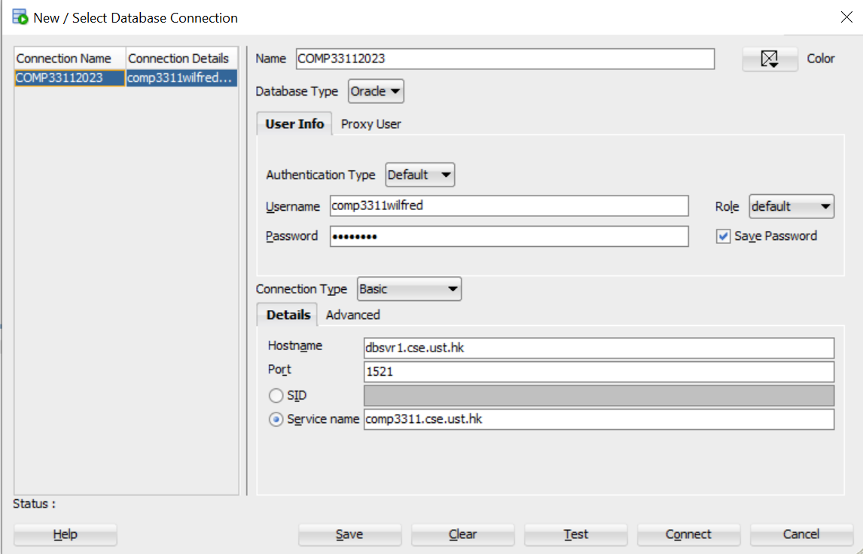
Connecting to Oracle database server 2
Find your account/password in oracle_account.xlsx

Slide 19
Appendix: Connecting to Oracle database server 3
Role: This is the set of privileges to be associated with the connection. Accept default for this connection.
OS Authentication: Leave this unchecked for this connection.
Proxy Connection: Leave this unchecked for this connection.
Hostname: This is the host system for the Oracle Database instance. Enter an IP address, a machine name, or localhost (when connecting to a database on the same machine as Oracle SQL Developer). The default is localhost .
Port: This is the listener port for the database. The default port for Oracle Database is 1521.
SID: This is the system identifier, such as orcl (the default for Oracle Database 10g and Oracle Database 11g) or xe (the default for Oracle Database 10g Express Edition).
Service name: This is the network service name of the database. Select either SID or Service name.
For database 12c, we use service name (comp3311.cse.ust.hk)

Slide 20
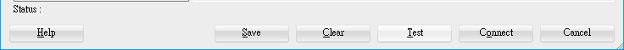
Connecting to Oracle database server 4
test connection
if status: Sucess, click Connect.
if status: Failure - Test failed: ORA-01017: invalid username/password; login denied, check your username and password. Make sure use the username provided in this lab.
if status: Status: Failure - Test failed: IO Error: The Network Adapter could not establish the connection, check if the computer connect to UST network. To connect to UST network, you can use the VPN mentioned in Appendix 2.

Slide 21
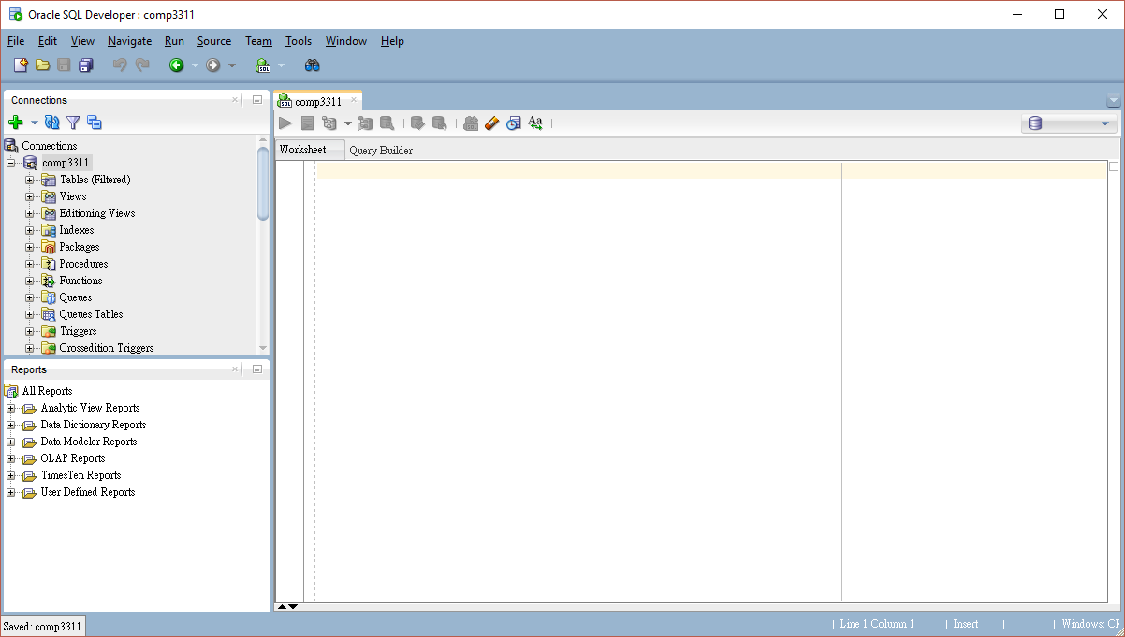
Connecting to Oracle database server 5
You will see something like this:

Slide 22
Changing your password 1
You are using the passwords from account2024.pdf, so you know one another’s passwords!
But you don’t want others to alter your database!
Please do not use others’ accounts and try to change others’ passwords.

Slide 23
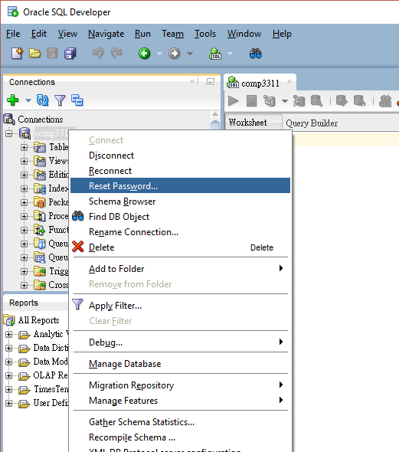
Changing your password 2
Right click connection
click Reset Password

Slide 24
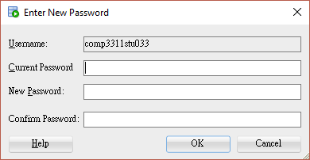
Changing your password 3
Enter current password
Enter new password twice
Click OK
Please remember the new password!

Slide 25
Changing your password: SQL statement
alter user <Oracle account> identified by <new_password>;
replace <Oracle account> and <new_password> with your Oracle account name and the new password.
Remember adding a “ ; ” at the end of the SQL statement, because all SQL statement ends in a “ ; ”.
Here is an example: alter user comp3311ta2 identified by “123456” ;

Slide 26
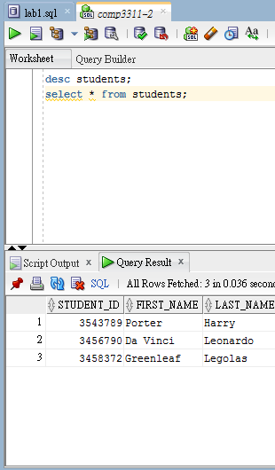
Script vs Query
run
statement
run script
Run Statement will give you a list of all the results in a sortable table. It will also only run the statement under the cursor (or highlighted).
Run Script will execute all statements in the worksheet, and give a text readout of the results.
The result will be shown in Query Result or Script Output.

Slide 27
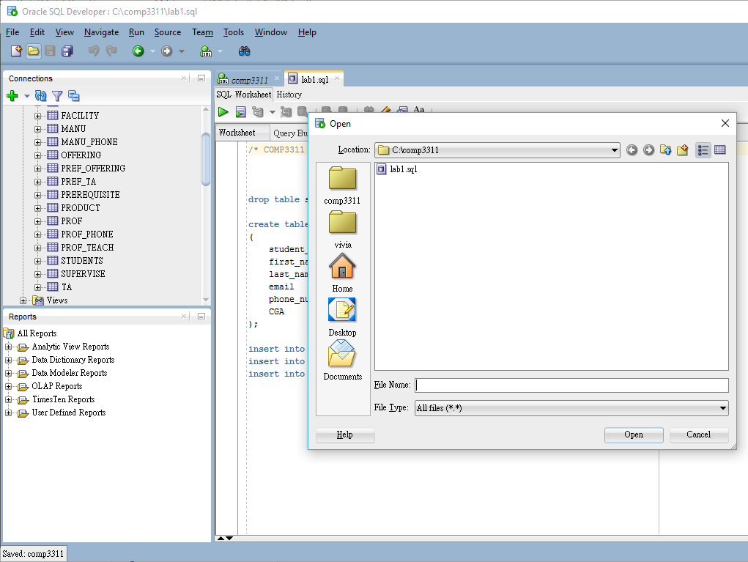
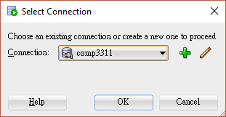
Running a SQL script file 1
Download (save) the lab1.sql file to the local file system from Canvas
Open file
Run script
Choose connection
1
4
2
3

Slide 28
Running a SQL script file 2
Basically lab1.sql creates a table called ‘students’ with 6 attributes.
And lab1.sql inserts 3 different instances of students into the table.
Don’t worry if you do not understand the SQL statements for the time being. We shall cover them in details in the future labs.

Slide 29
Running a SQL script file 3
You should get below result in Script Output after successfully run lab1.sql
Table STUDENTS dropped.
Table STUDENTS created.
1 row inserted.
1 row inserted.
1 row inserted.

Slide 30
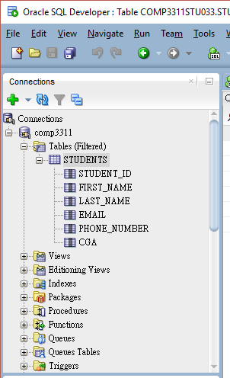
Browsing Database Objects 1
Expand the connection objects under current connection in connection navigator
Expand “Tables”
Refresh if no table is shown
Select “STUDENTS”
the table structure is shown

Slide 31
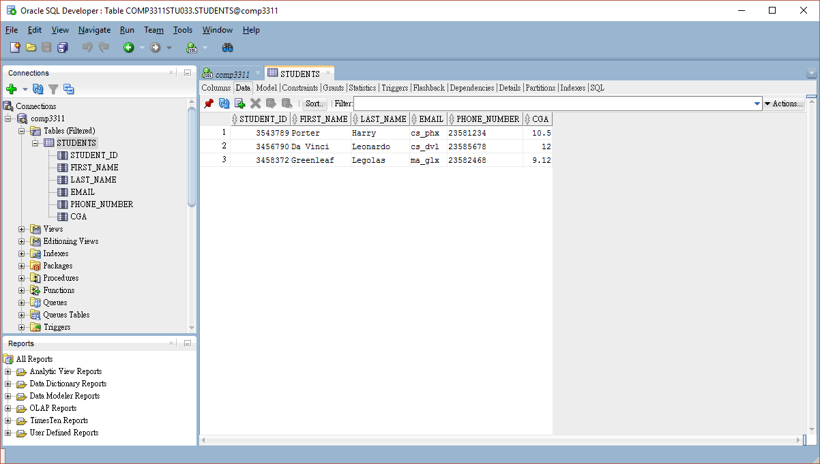
Browsing Database Objects 2

Slide 32
SQL Worksheet
You can use the SQL Worksheet to enter and execute
SQL
PL/SQL
SQL*Plus statements

Slide 33
Using the SQL Worksheet
You can display a SQL Worksheet by
right-clicking a connection in the Connections navigator and selecting Open SQL Worksheet
by selecting Tools and then SQL Worksheet, or
by clicking the Use SQL Worksheet icon under the menu bar.

Slide 34
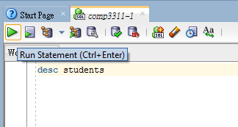
Displaying the table structure with SQL statement
Command: DESC[RIBE] <tablename>
example: desc students
switch to worksheet
type desc students in worksheet
keep the cursor on this line
run statement
result will be shown in Script Output
What you see?
Null? – Means whether a column must contain data
Type – The data type of the column
NUMBER(p, s) – A number of p digits, s decimal points
VARCHAR(s) – Variable characters of max. length s

Slide 35
About notations in this Lab
Command: DESC[RIBE] <tablename>
<tablename> represents the name of the table, no need to type <>
DESC[RIBE] indicates that you can either type describe or desc for short. You can omit the characters in the []

Slide 36
Conclusions
We covered the following topics in this lab:
Introduction to some background of Oracle DBMS
Introduction to SQL Developer
Connecting to the Oracle DBMS through SQL Developer
Running simple SQL scripts in SQL Developer
Editing SQL statements in SQL Developer

